Slide 1
Lecture 13:
Automated Test Case Generation
Gregory Gay
DIT636/DAT560 - February 22, 2023

Slide 2

Automating Test Creation
Testing is invaluable, but expensive.
We test for *many* purposes.
Near-infinite number of possible tests we could try.
Hard to achieve meaningful volume.
Notes:
We must produce reliable, robust software. Testing is invaluable in that quest. The downside, of course, is that testing is also very expensive especially since we test for *many* purposes, validating correctness, assessing performance, looking for security vulnerabilities, memory leaks, excessive battery usage, and so on. Any real-world piece of software with value has (3-4).

Slide 3

Automation of Test Creation
Relieve cost by automating test creation.
Repetitive tasks that do not need human attention.
Generate test input.
Need to add assertions.
Or check for crashes, memory leaks, other problems that can be measured automatically.
Automation!
Tests are generating!
Notes:
However, we live in the age of automation - of AI, of big data and deep learning, and all of that. Can’t we do something about this? This cost, the remendous amount of manual, fallable human effort going into testing, could be relieved by automating part, at least, of the creation process. Now, we don’t *yet* have magic AI yet where we can press a button, go have fika, and come back to tested software. But, there are practical, usable means of automating parts of testing. We can look for (2), and see what we can do about those. For instance, our focus todat is on how we can automate input generation. WE can Have a program come up with ways to poke and prod the system in interesting ways. The algorithm can create test cases with input for us, and then we just need to add test oracles. So, you can use automation in two ways here. The first is that you can generate input and have a human add assertions, still some human effort but can still save time - especially if you have a good set of general assertions describing properties of correct output. Or, in many cases, we just want to see crashes or exceptions - then we don’t need human help at all - fuzzers, for instance, can very effectively find crashes, overflows, and other security vulnerabilities without human intervention.

Slide 4
Today’s Goals
Introduce Search-Based Test Generation
(AKA: Fuzzing)
Test Creation as a Search Problem
Metaheuristic Search Algorithms
Fitness Functions

Slide 5
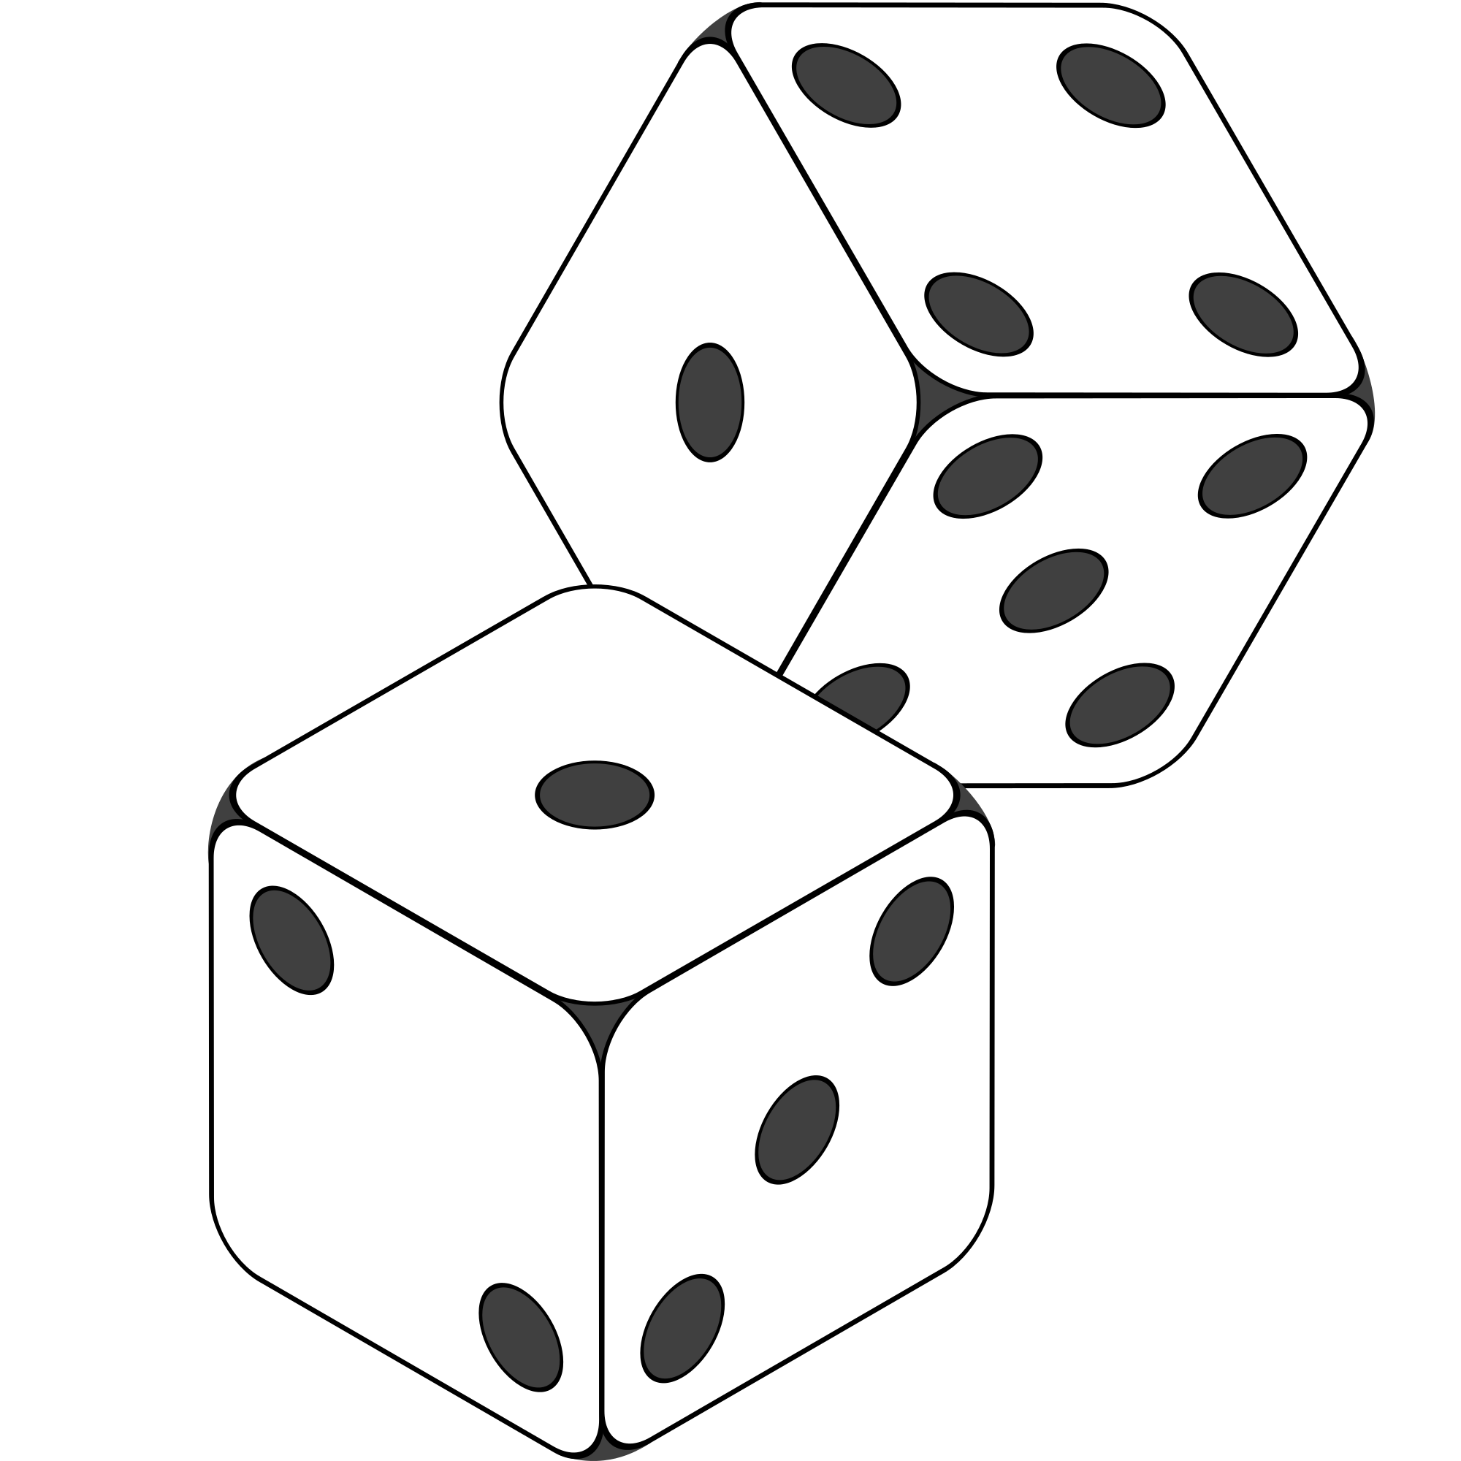
Random Generation
Randomly formulate test cases.
Unit testing: choose a class in the system, choose random methods, call with random parameter values.
System-level testing: choose an interface, choose random functions from interface, call with random values.
Keep trying until goal attained or you run out of time.
Notes:
Before we get into fancy techniques, let’s start simple, and the simplest form of test generation is purely random generation, which is where we (1) If we’re unit testing, choose a class in the system. Generate a series of method calls to that class. Random number of calls, range 1-(max test case size). Methods to call chosen randomly from list of methods. Method parameters generated randomly. Random integer, random string, etc. Run those tests, see if they meet your goals. If system-level tests, we’re looking at a similar strategy. Generate a series of calls to an API, CLI, or GUI up to a set max test size. Set the parameters of those randomly. Run them and see what happens. You get the point. Generate a set of test cases completely at random, try them. If it doesn’t meet whatever goal you have - say finding crashes - try another solution. Keep trying until the goal is attained or budget expires. Pretty straightforward. Let’s take a closer look at what that might look like, since this is a major building block of where we will end up.

Slide 6
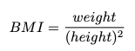
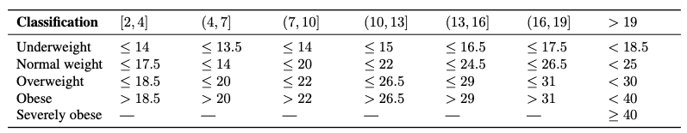
Example - BMI Calculation
BMICalc
height
weight
age
bmi_value()
classify_bmi_adults()
classify_bmi_teens_and_children()
Age
Notes:
We can illustrate concepts related to automated test generation using a class that implements different variants of a body mass index (BMI) classification . BMI is a value obtained from a person’s weight and height to classify them as underweight, normal weight, overweight, or obese. There are two core parts to the BMI implementation: (i) the BMI value, and (ii) the BMI classification. The BMI value is calculated as weight/height^2 using height in meters (m) and weight in kilos (kg). In turn, the BMI classification uses the BMI value to classify individuals based on different threshold values that vary based on the person’s age and gender. The BMI thresholds for children and teenagers vary across different age ranges (e.g., from 4 to 19 years old). As a result, the branching options quickly expand.The BMI classification is particularly interesting case for testing because, (i), it has numerous branching statements based on multiple input arguments (age, height, weight, etc.), and (ii), it requires testers to think of specific combinations of all arguments to yield BMI values able to cover all possible classifications. (point to table). the BMICalc class we are testing has three variables: age, height, and weight. Then, there are methods we can call to get the BMI value and then two methods for BMI classification - one for adults and one for children/teens.

Slide 7
Example - BMI Calculation
def test_bmi_value_valid():
bmi_calc = BMICalc(150, 41, 18)
bmi_value = bmi_calc.bmi_value()
assert bmi_value == 18.2
def test_bmi_adult():
bmi_calc = BMICalc(160, 65, 21)
bmi_class = bmi_calc.classify_bmi_adults()
assert bmi_class == "Overweight"
def test_bmi_children_4y():
bmi_calc = BMICalc(100, 13, 4)
bmi_class = bmi_calc.classify_bmi_teens_and_children()
assert bmi_class == "Underweight"
BMICalc
height
weight
age
bmi_value()
classify_bmi_adults()
classify_bmi_teens_and_children()
Notes:
Here are three unit tests we might write for this class, written in the Python pytest unit testing framework. The first is a test of the BMI value calculation. We set up the class with a height of 150 cm, weight of 41 kg, and an age of 18. We get the value, and we check that it is what we would expect, which is 18.2. In the second, we check the classification of an adult - a 21 year old with 160 cm height and 65 kg weight, we call the classification method for adults, and we assert that the resulting classification is overweight. The third is similar, for a 4 year old child who is 100 cm tall and 13 kg, who we expect to be underweight.

Slide 8
Random Generation - BMI Example
Create an empty test case:
def test_1():
Instantiate the class-under-test with random values:
def test_1(): cut = BMICalc(180, 50, 40)
Insert 1+ method calls or assignments to class variables.
Number of calls is random
Which method/variable is random
Method parameters are random values
BMICalc
height
weight
age
bmi_value()
classify_bmi_adults()
classify_bmi_teens_and_children()
def test_1(): cut = BMICalc(180, 50, 40) output = cut.bmi_value() cut.height = 15681 output2 = cut.classify_bmi_adults()
Notes:
Now, to generate random unit tests for this, we might first create an empty test case with a unique name. Then, we would instantiate the class-under-test by generating random values for the constructor. Then, we would generate one or more method calls to any of the available methods. All aspects of this selection are random (last three points). So, a test case might look like this. And this would be a weird test case, as we suddenly changed the height to 15681. This person would be pretty underweight at that height.

Slide 9
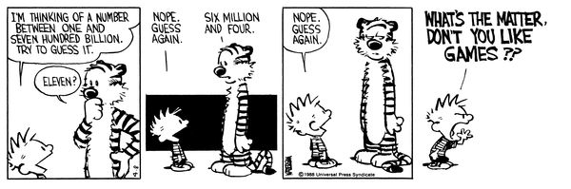
Random Search
Sometime viable:
Extremely fast.
Easy to implement, easy to understand.
All inputs considered equal, so no designer bias.
However…
Notes:
Random search is actually a somewhat common method of automatically generating test inputs. (1) There is no overhead, no complex planning, just pick and try. Nothing beats it on pure speed per guess. It’s easy to understand, easy to implement. All inputs considered equal, so no designer bias. It is absolutely a viable method of testing some systems, especially if you’re just looking for crashes - just spam that system with input. If you can try 10000 things in 5 minutes, you might stumble on a fault. However… (comic). The challenge with purely random test generation is that most systems have a near-infinite number of possible test cases, especially when we look at not just one call but a series of method calls. We can’t try everything, and there is no information to help us come up with good test cases. We need something a little smarter, which is where the concept of search-based test generation comes into the picture.

Slide 10
Test Creation as a Search Problem
Do you have a goal in mind when testing?
Make the program crash, achieve code coverage, cover all 2-way interactions, …
You are searching for a test suite that achieves that goal.
Search-based test generation based on guess-and-check process.
Notes:
Test input selection can naturally be seen as a search problem. When you create test cases, you often have one or more goals. Perhaps that goal is to find violations of a specification, to assess performance, to achieve code coverage, or any number of other things that we may have in mind when we design test cases. We cannot try all input. However, somewhere in that space of possibilities lies a subset of inputs that best meets the goals we have in mind. Out of all of the test cases that could be generated, we want to identify—systematically and at a reasonable cost—those that best meet those goals. Search-based test generation is an intuitive AI technique for locating those test cases that maps to the same process we might use ourselves to find a solution to a problem. Let us consider a situation where you are asked a question. If you do not know the answer, you might make a guess—either be an educated guess or one made completely at random. In either case, you would then get some feedback. How close were you to reaching the “correct” answer? If your answer was not correct, you could then make a second guess. Your second guess, if nothing else, should be closer to being correct based on the knowledge gained from the feedback on that initial guess. If you are still not correct, you might then make a third, fourth, etc. guess—each time incorporating feedback on the previous guess.

Slide 11
Test Creation as a Search Problem
Many testing goals can be measured:
How many exceptions were thrown?
How many representative output values were returned?
What percentage of lines of code were covered?
How diverse is our input?
If goal can be measured, search can be automated.
Notes:
Test input generation can be mapped to the same process. We start with a problem we want to solve. We have some goal that we want to achieve through the creation of unit tests. If that goal can be measured, then we can automate input generation. Fortunately, many testing goals can be measured. • If we are interested in exploring the exceptions a class can throw, then we want the inputs that trigger the most exceptions. • If we are interested in covering all outcomes of a function, then we can divide the output into representative values and identify the inputs that cover all representative output values. • If we are interested in executing all lines of code, then we are searching for the inputs that cover more of the code structure. • If we are interested in executing a wide variety of input, then we want to find a set of inputs with the highest diversity in their values. Attainment of many goals can be measured, whether as a percentage of a known checklist or just a count that we want to maximize. Even if we have a higher-level goal in mind that cannot be directly measured, there may be measurable sub-goals that correlate with that higher-level goal. For example, “find faults” cannot be measured—we do not know what faults are in our goal—but maximizing code coverage or covering diverse outputs may increase the likelihood of detecting a fault. Once we have a measurable goal, we can automate the guess-and-check process outlined above via a metaheuristic optimization algorithm.

Slide 12

Search-Based Test Generation
Make one or more guesses.
Generate one or more individual test cases or full test suites.
Check whether goal is met.
Score each guess.
Try until time runs out.
Alter the solution based on feedback and try again!
Notes:
The rough idea of a search process is that you (1-2). (3) Score each solution based on their attainment of the overall goals. Then (5) Alter the population of guesses based on our search stragegy- our metaheuristic and potentially feedback from those scores - and try again.

Slide 13
Search Strategy
The order that solutions are tried is the key to efficiently finding a solution.
A search follows some defined strategy.
Called a “metaheuristic”.
Metaheuristics are used to choose solutions and to ignore solutions known to be unviable.
Smarter than pure random guessing!
Notes:
Given that near-infinite number of possible inputs, (1). We want to spend the shortest time we can to find a solution that meets our goals. As a result, all search techniques follow a defined strategy, the search heuristic. (4)
If other solutions share properties with candidates already tried that rule them out as candidates, you can choose to ignore them in favor of other candidates. Metaheuristics determine the order that we explore the search space. (last point)

Slide 14
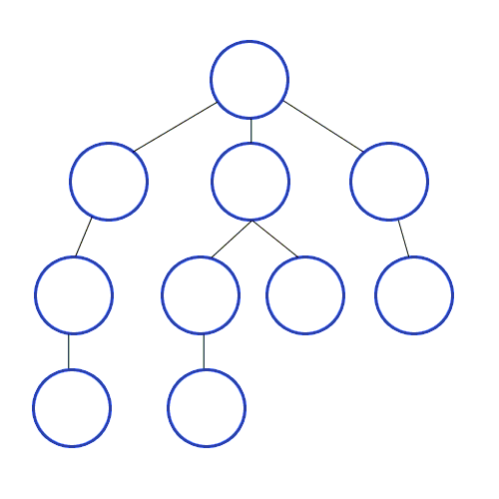
Heuristics - Graph Search
Arrange nodes into a hierarchy.
Breadth-first search looks at all nodes on the same level.
Depth-first search drops down hierarchy until backtracking must occur.
Attempt to estimate shortest path.
A* search examines distance traveled and estimates optimal next step.
Requires domain-specific scoring function.
Notes:
To give you an idea of the range of heuristics available to solve problems, let’s look at a problem domain you might be familiar with already. You’ve all taken some kind of algorithms or data strcutures course. Then you probably talked about graphs. Given a directed acyclic graph, we might want to find a particular node of interst, and we aren’t sure where it is. One family of heuristics arranges nodes into a hierarchy and explores them. Breadth-first search explores a graph by trying all nodes one level deeper than the current node. Depth-first search jumps checks a node, and if it has a child, jumps to it - not looking at other nodes on the same level until backtracking must occur. Other strategies attempt to estimate the shortest path using a cost function - incorporating domain-based knowledge. A* search finds a path through a graph by calculating the distance travelled so far and examining all “next moves” and estimating which will get them closest to the goal (last) but if you choose a good scoring function, you can get to a solution much faster than when you just try to explore everything. A* is useful approach for things like robot pathfinding - hills are harder to climb than flat ground, so you can steer around them and get to a goal with more battery life left or at a faster speed. From this, you can see a range of different heuristics. Some are faster than others, some are easier to understand and implement. Some require deep knowledge and understanding, others will work well without this understanding. Likewise, in search-based test generation, there are different heuristics we can use to sample the input space. Some are more complex than others, some work better for specific problems.

Slide 15
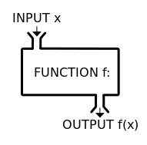


Search-Based Test Generation
+
=
The Metaheuristic
(Sampling Strategy)
Genetic Algorithm
Simulated Annealing
Hill Climber
(...)
The Fitness Functions
(Feedback Strategies)
Distance to Coverage Goals
Count of Executions Thrown
Input or Output Diversity
(...)
(Goals)
Cause Crashes
Cover Code Structure, Generate Covering Array,
(...)
Notes:
Search-based test generation is more similar to something like A*, where we incorporate some domain expertise on what we are looking for. This process is powered by metaheuristic optimization algorithms which define how we select and modify test cases. The metaheuristic is guided by feedback from one or more fintess functions. scoring mechanisms that tells you good a proposed solution is. How close is it to meeting our goals? The metaheuristic takes feedback from the Testing has one of more goals, such as executing certain code elelements, driving the system to throw exceptions, detecting planted faults. The fitness functions offer feedback, based on those goals, to shape the test suites, ideally in a way that brings us closer to our goals.

Slide 16
Solution Representation

Slide 17
Solution Representation
Must decide what a solution “looks like”.
For unit testing:
A solution is a test suite.
A test suite contains 1+ test cases.
Each test case interacts with a class-under-test.
Each test case initialized the class-under-test.
Each test case contains one or more actions.
An action is a method call or variable assignment.
Each action has parameters (method parameters or values to assign to variables).
Notes:
When solving any problem, we first must define the form the solution to the problem must take. What, exactly, does a solution to a problem “look” like? What are its contents? How can it be manipulated? Answering these questions is
crucial before we can define how to identify the “best” solution. In this case, we might be interested in identifying a set of unit tests that maximise attainment of a testing goal. This means that a solution is a test suite—a collection of test cases. We can start from this decision, and break it down into theelements relevant to our problem. • A solution is a test suite. • A test suite contains one or more test cases, expressed as individual methods of a single test class. • The solution interacts with a unit-under-test (UUT) which is a single, identified class with a constructor (optional) and one or more methods. • Each test case contains an initialization of the CUT which is a call to its constructor, if it has one. • Each test case then contains one or more actions, i.e., calls to one of the methods of the CUT or assignments to a class variable. • The initialization and each action have zero or more parameters (input) supplied to that action.
This means that we can think of a test suite as a collection of test cases, and each test case as a single initialization and a collection of actions, with associated parameters. When we generate a solution, we choose a number of test cases to create. For each of those test cases, we choose a number of actions to generate. Different solutions can differ in size—they can have differing numbers of test cases—and each test case can differ in size—each can contain a differing number of actions

Slide 18
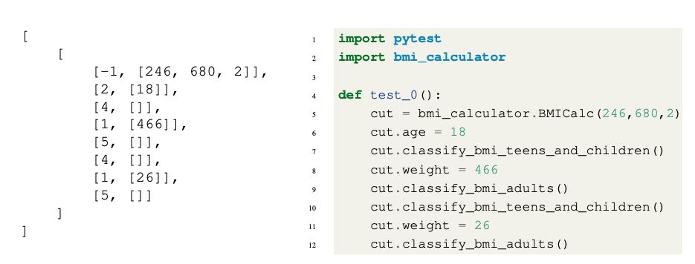
External vs Internal Representation
Internal (Genotype) Representation
Can be easily manipulated by metaheuristic
External (Phenotype) Representation
Executable, human-readable
Test Suite
Test Case
Actions, with ID (method or variable), parameters
Notes:
In search-based test generation, we represent two solutions in two different forms: Phenotype (External) Representation: The phenotype is the version of the solution that will be presented to an external audience. This is typically in a human-readable form for a test case. What we have on the right here on the slide. The phenotype representation takes the form of an executable test class. In turn, each test case is a method containing an initialization, followed by a series of method calls or assignments to class variables, as we discussed. This can be run directly and read by humans. • Genotype (Internal) Representation: The genotype is a representation used internally, within the metaheuristic algorithm. This version includes the properties of the solution that are relevant to the search algorithm, e.g., the elements that can be manipulated directly. It is generally a minimal representation that can be easily manipulated by a program. The external representation is not ideal for use by the metaheuristic search algorithm as it cannot be easily manipulated. If we wanted to change one method call to another, we would have to identify which methods were being called. If we wanted to change the value assigned to a variable, we would have to identify (a) which variable was being assigned a value, (b) identify the portion of the line that represents the value, and (c), change that value to another. Internally, we require a representation that can be manipulated quickly and easily. This is on the left. A test suite is a list of test cases. If we want to add a test case, we can simply append it to the list. If we want to access or delete an existing test case,
we can simply select an index from the list. Each test case is a list of actions. Similarly, we can simply refer to the index of an action of interest. Each action is a list containing (a) an action identifier - referring to a specific method call or variable that we can assign values to- and (b), a list of parameters to that action. An identifier of −1 is reserved for the constructor

Slide 19
Fitness Functions

Slide 20
Fitness Functions
Domain-based scoring functions that determine how good a potential solution is.
Should represent goals of tester.
Must return a numeric score.
% of a checklist
raw number
NOT Boolean (no feedback)
Can be maximized or minimized.
Notes:
As previously-mentioned, fitness functions are the cornerstone of search-based test generation. The core concept is simple and flexible—a fitness function is simply a function that takes in a solution candidate and returns a “score” describing the quality of that solution. This gives us the means to differentiate one solution from another, and more importantly, to tell if one solution is better than another. Fitness functions are meant to embody the goals of the tester. They tell us how close a test suite came to meeting those goals. The fitness functions employed determine what properties the final solution produced by the algorithm will have, and shape the evolution of those solutions by providing a target for optimization.
Essentially any function can serve as a fitness function, as long as it returns a numeric score. It is common to use a function that emits either a percentage (e.g., percentage of a checklist completed) or a raw number as a score, then either maximise or minimise that score. A fitness function should not return a Boolean value. This offers almost no feedback to improve the solution.

Slide 21
Fitness Functions
Should offer feedback:
Small change in solution should not lead to large change in score.
Informative functions calculate distance to optimality.
Can optimize more than one at once.
Independently optimize functions
Combine into single score.
Notes:
A fitness function should yield (largely) continuous scores. A small change in a solution should not cause a large change (either positive or negative) in the resulting score. Continuity in the scoring offers clearer feedback to the metaheuristic algorithm. • The best fitness functions offer not just an indication of quality, but a distance to the optimal quality. For example, rather than measuring completion of a checklist of items, we might offer some indication of how close a solution came to completing the remaining items on that checklist. We’ll show an example of that in a second. Depending on the algorithm employed, either a single fitness function or multiple fitness functions can be optimised at once. If multiple are optimized, all functions will shape the final test suite, so this is often a nice way to get versatile tests. We can optimize multiple fintness functions in two ways. we can either try to balance multiple functions, finding solutions that improve all scores for all functions as much as possible without hurting the scores of other functions. This is very effective, but can be very difficutl. The second thing is that we can create a single combined score as a linear combination of scores of the individual functions. This is easier and often works well, but allows maximization of one function at the expense of others.

Slide 22
Example - Code Coverage
Goal: Attain Branch Coverage over the code.
Tests must reach all branching points (i.e., if-statement) and execute all possible outcomes.
if(x < 10){
// Do something.
}else if (x == 10){
// Do something else.
}
In this code:
Two Branches
Each must evaluate to true and false.
Notes:
So, to give an example, let’s take a code coverage measurement called branch coverage. When we measure branch coverage, we look at the decision points in a program - if statements, loop statements - for, while, foreach, etc, switch statements, and ensure that we try the different outcomes - true and false for if-statements and loop conditions, the different cases for a switch. The idea is that tests that cover the different outcomes of these statements will do a good job of thoroughly touching each line of code, making those tests more likely to expose bugs. This is often used to decide when you’re done testing - did you cover every branch outcome? In this little bit of code, we have two branching points. We want each to evaluate to false and each to evaluate to true when we execute our test cases. If all of these branching pioints evaluate to all possible outcomes, we achieve branch coverage.

Slide 23
Example - Code Coverage
Goal: Attain Branch Coverage over the code.
Fitness function (Basic):
Measure coverage and try to maximize % covered.
Good: Measurable indicator of progress. Can use standard tools (pytest-cov, Cobertura).
Bad: No information on how to improve coverage.
Notes:
Branch coverage is a good goal for test generation, as we can measure it without a human present. This means we can try to optimize it. Now, how would you design a fitness function for it? Well, as a first attempt, we could just measure coverage and try to maximize that percentage. There are standard tools to perform this calculation, like pytest-cov in Python or in Java, we can use Cobertura or IntelliJ has built-in tools that can measure this. This can be very effective as a fitness function. However, it’s main weakness is that it only tells us what we have covered. This dopes not tell us much about how to improve solutions. We can tell how good any one solution is, but have to way to compare two solutions with equal coverage to see which could be improved more easily. Instead - what we want to know is whether we can we score a test such that we can learn from the attempt? Not just “is this good”, but “how close is this to being THE BEST”. That leads to an even better fitness function.

Slide 24
Example - Code Coverage
Advanced: Distance-Based Function
fitness = branch distance + approach level
Approach level
Number of branching points we need to execute to get to the target branching point.
Branch distance
If other outcome is taken, how “close” was the target outcome?
How much do we need to change program values to get the outcome we wanted?
Notes:
So, generally, we don’t directly use branch coverage as the fitness function. Instead, a common fitness function for branch coverage is to target a single branch and outcome at a time, execute a test, and calculate two things - called the branch distance and approach level. The approach level is defined as the count of the target branch's control-dependent predecessors that have not been executed---that means the earlier branches in the code that we need to pass through to get to this point - how many if-statements, loops statements, and switches need to execute in the manner we desire to get to THIS branch. It is essentially a directional indicator. It gets lower as the execution path gets closer to the target branch.
now, if we reach the right line of code where the target branch exists, but get the wrong outcome - say true when we wanted false - the branch distance kicks in. Branch distance is computed from the point where the execution path diverged from the targeted branch. If an undesired outcome is taken, branch distance describes how ``close'' we were to the outcome we wanted, using a cost function based on the formula of that statement. (last point) Let’s look at an example of this.

Slide 25
Example - Branch Coverage
if(x < 10){ // Branch 1
// Do something.
}else if (x == 10){ // Branch 2
// Do something else.
}
Approach Level
If Branch 1 is true, approach level = 1
If Branch 1 is false, approach level = 0
Branch Distance
If x==10 evaluates to false, branch distance = (abs(x-10)+k).
Closer x is to 10, closer the branch distance.
Goal: Branch 2, True Outcome
Notes:
Suppose that the current goal is to execute the \texttt{true} outcome of branching point 2. If branching point 1 is reached and evaluates to \texttt{true}, then the approach level is 1. We are one branching point away from our target. If, instead, \texttt{x == 10} - branching point 2 - is reached, then the approach level is 0, as the target branching point has been reached. If \texttt{x == 10} evaluates to \texttt{false}, then we didn’t get the outcome we wanted. In that case, we check branch distance using the formula \texttt{abs(x-10) + k}, where k is a small constant. The closer \texttt{x} is to 10, the closer the targeted outcome was to being hit. We get the exact formula based on the contents of the if-statement, but the general idea is the same. this gives us some information to work with. We know how close a test is to giving the outcome we wanted, and this arms the search with the ability to get a little bit closer each time to hitting that outcome. If two solutions give us the same total branch coverage, we can favor the one that gets us closer to covering the remaining branches - that have the smallest approach level and branch distance.

Slide 26
Other Common Fitness Functions
Number of methods called by test suite
Number of crashes or exceptions thrown
Diversity of input or output
Detection of planted faults
Amount of energy consumed
Amount of data downloaded/uploaded
… (anything that reflects what a good test is)
Notes:
(go over). Great thing is the flexibility of this method. Fitness functions shape a test suite, based on what you feel is a good test suite. Anything that can be measured efficiently can be used as a fitness function. And, you often choose a couple of these and try to optimize them all at once, shaping an effective test suite.

Slide 27
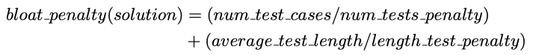
Bloat Penalty
Small penalty subtracted from fitness.
Limits number of tests and number of actions.
Important not to penalize too heavily.
ex. 10
ex. 30
Notes:
When calculating fitness, we often incorporate small additional properties related to what results in a good test suite. A very common thing to do is to subtract from the fitness score a bloat penalty. The bloat penalty is a small penaltintended to control the size of the produced solution in two dimensions: the number of test cases, and the number of actions in each test. A massive test suite may attain high code coverage, but it is likely to contain many redundant elements as well. In addition, it will be more difficult to understand when read by a human. In particular, long sequences of actions may hinder efforts to debug the code and identify a fault. Therefore, we use the bloat penalty to encourage the metaheuristic algorithm to produce small-but-effective test suites. The bloat penalty is calculated as follows: (num test cases/num tests penalty) + (average test length/length test penalty). The penalties are weighrts that a tester can adjust, for example
num tests penalty is 10 and length test penalty is 30. That is, we divide the number of test cases by 10 and the average length of a single test case (number of actions) by 30. It is important to not penalise too heavily, as that will increase
the difficulty of the core optimization task—some expansion in the number of tests or length of a test is needed to cover the branching structure of the code. These penalty values allow some exploration while still encouraging the
metaheuristic to locate smaller solutions.

Slide 28
Let’s take a break.
Notes:
10 minute break

Slide 29
Metaheuristic Algorithms

Slide 30
The Metaheuristic
Decides how to select and revise solutions.
Changes approach based on past guesses.
Fitness functions give feedback.
Population mechanisms choose new solutions and determine how solutions evolve.
Notes:
We need to choose a smart strategy to sample from the search space. The metaheuristic decides how to select and revise solutions and Changes its approach based on past guesses by trying to learn something about what we just tried. The metaheuristic makes a purely random guess on the first attempt, then gets feedback from the fitness functions - often not just whether or not it was a good test, but how close it was to being the best test. The algorithm and fitness function form a symbiotic relationship where the algorithm tries a solution, finds out whether it meets our goals, then uses its score in conjunction with a set of population manipulation mechanisms to generate new solutions and iterate on the best solutions.

Slide 31
The Metaheuristic
Decides how to select and revise solutions.
Small changes to single solution (local search) or larger changes to multiple solutions (global search).
Often based on natural phenomena (swarm behavior, evolution).
Trade-off between speed, complexity, and understandability.
Notes:
There are two main families of metaheuristics, local searches - which tend to focus on a single solution at a time and make small adjustments. global searches focus on multiple solutions and tend to make larger changes to them.
The core strategies used by many of these are based on (3). In any case, the choice of metaheuristic is a (4). Some are very fast, but vulnerable to getting trapped when a bad guess is made. Some are better for certain problems. Some are very complex and will give you a better solution, but require a substantial time investment. There are a number of trade-offs to consider. We will present two here - a simple hill climber, then a more complex genetic algorithm - which is slower, but potentially produces more robust solutions.

Slide 32
How Long Do We Spend Searching?
Exhaustive search not viable.
Search can be bound by a search budget.
Number of guesses.
Time allotted to the search (number of minutes/seconds).
Optimization problem:
Best solution possible before running out of budget.
Notes:
We place an end point on the search using our search budget. This can come in two forms. Either the number of attempts made. Or the total time allocated to the search, in minutes, seconds. We will allow two minutes to come up with something. Without an exhaustive search, we can make no guarantees about finding the best possible solution. We can’t ensure the goal is met, we can’t ensure it can be met, and we can’t promise the most optimal solution. What we try to do is choose a metaheuristic that delivers the best solution possible before we run out of time or guesses.

Slide 33
Local Search
Generate and score a single potential solution.
Attempt to improve by looking at its neighborhood.
Make small, incremental improvements.
Very fast, efficient if good initial guess.
Get “stuck” if bad guess.
Often include reset strategies.
Notes:
Local searches tend to be pretty simple (1). In local search, this is generally one solution at a time, while in globalb searches, we often evolve a population of solutions in parallel. Then, (2). The neighbors are any test cases that could be generated by making a small incremental change to the current solution. The idea is that, if you’re pretty good already, you might improve by making a tiny, tiny change. If you do, try to improve again, and keep going until you can’t get any better. Local searches tend to be very easy to implement and are very fast to execute as long as you picked a good starting point. That’s the big issue, though. If you didn’t make a good initial guess, you can get stuck in a particular region of the solution space, unable to find a good solution. The basic thing that you can do to help with this is to add restarts when you get stuck.

Slide 34
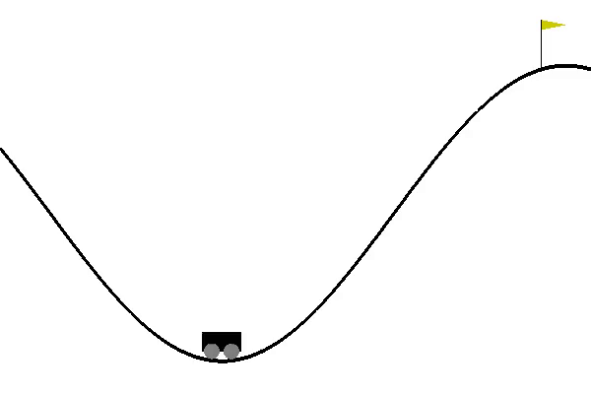
Hill Climbing
Generate a random initial solution.
Each generation (while budget remains):
Attempt up to max_tries mutations to the solution.
If a mutation results in a better solution, set this as the new solution.
Keep track of the best mutation seen to date.
If we run out of tries, reset to a new random initial solution.
Notes:
The basic form of local search is called hill climbing. A Hill Climber is a classic metaheuristic that embodies the “guess-and-check” process we discussed earlier. The algorithm makes an initial guess purely at random, then attempts to improve that guess by making small, iterative changes to it. While we still have search budget remaining, we attempt to improve this solution over a series of generations of evolution. Each generation, we get a set number of attempts to improve the solution. We impose a mutation to the current solution - a small change. If that change results in a better score, we adopt the mutated solution as our new solution and continue to the next generation - keeping track all along iof the best solution we have ever seen. If we run our of tries, we restart with a new completely random solution. We can think of the landscape of possible solutions as a topographical map, where better fitness scores represent higher levels of elevation in the landscape. This algorithm is called a “Hill Climber” because it attempts to scale that landscape, finding the tallest peak that it can in its local neighborhood. At times, we reach a point where we can’t improve the fitness any further. We refer to these situations at local optima. If we reach a local optima, we need to move to a new “neighborhood” in order to find taller peaks to ascend. At the end, you return the best solution you saw during that run.

Slide 35
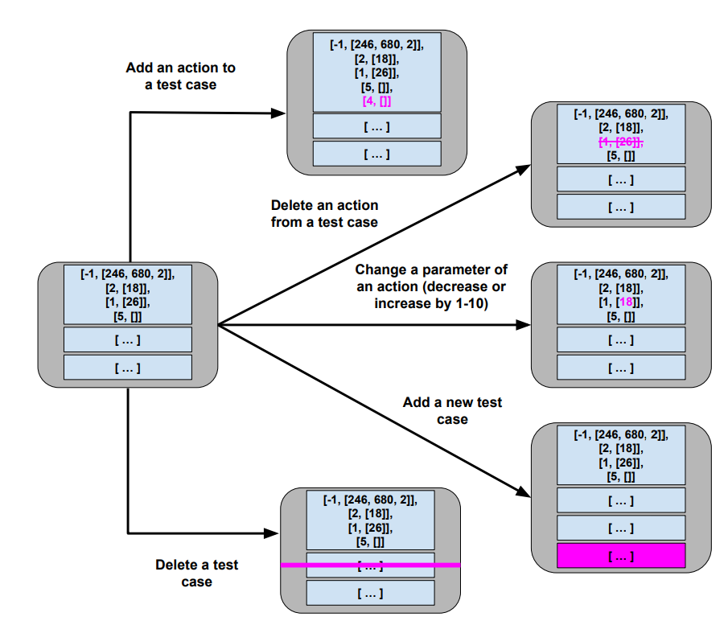
Mutation
Small change to current solution.
Impose one of these changes at a time:
Notes:
Each generation, we attempt to improve the current solution through the process of mutation. During mutation, we introduce one small change to the current solution from the set on this slide. (go over each).

Slide 36
Hill Climber
User-Controlled Parameters:
Maximum mutations before a restart (ex: 200)
Maximum number of restarts (ex: 5)
Easy to implement, faster than many other metaheuristics.
Reliant on initial guesses and restarts.
Notes:
To control this process, we use two user-controllable parameters. • Maximum Number of Tries: A limit on the number of mutations we are willing to try before restarting. By default, this is set to 200. • Maximum Number of Restarts: A limit of restarts we are willing to try before giving up on the search. Be default, this is set to 5. The core process employed by the Hill Climber is simple, but effective. Hill Climbers also tend to be faster than many other metaheuristics. This makes them a popular starting point for search-based automation. Their primary weakness is that reliance on making a good initial guess. A bad initial guess could result in time wasted exploring a relatively “flat” neighborhood in that search landscape. Restarts are essential to overcoming that limitation

Slide 37
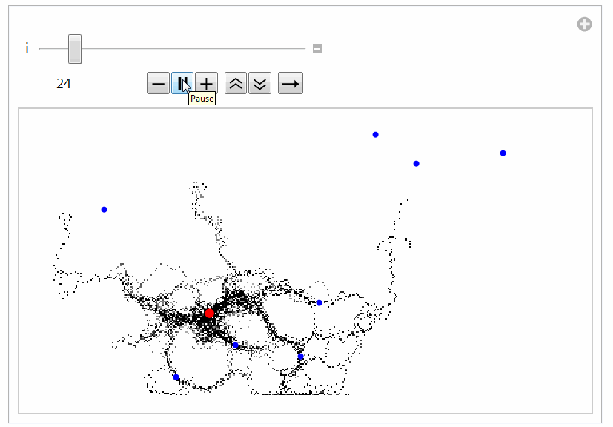
Global Search
Generate multiple solutions.
Evolve by examining whole search space.
Typically based on natural processes.
Swarm patterns, foraging behavior, evolution.
Models of how populations interact and change.
Notes:
Global searches are pretty similar conceptually, but with a couple of differences. You still form solutions, score them, then improve them. The first key difference, though, is that global searches evolve populations of solutions in parallel instead of single solutions. Then, all of the global searches have a strategy in place to sample from the whole search space instead of strictly sitting in the local neighborhood of any one solution. They don’t just impose mutations, but may have other mechanisms for promoting and combining different solutions. They tend to be inspired by some natural process. The most famous, genetic algorithms, are based on how species evolve over time, with mechansims modeling mutation and breeding and how those influence the gene pool. Particle swarm optimization looks at how swarms of insects explore a space. Ant colony optimization is based on how ants forage for food and lead other ants to food that they have discovered so it can be brought back to a hive. In general, global searches tend to (last). Let’s go over the most famous of these, and most common, the genetic algorithm.

Slide 38

Genetic Algorithm
Over multiple generations, evolve a population.
Good solutions persist and reproduce.
Bad solutions are filtered out.
Diversity is introduced by:
Selecting the best solutions.
Creating “offspring” through mutation and crossover.
Notes:
Genetic Algorithms model the evolution of a population over time. In a population, certain individuals may be “fitter” than others, possessing traits that lead them to thrive—traits that we would like to see passed forward to the next
generation through reproduction with other fit individuals. Over time, random mutations introduced into the population may also introduce advantages that are also passed forward to the next generation. Over time, through mutation and
reproduction, the overall population will grow stronger and stronger. As a metaheuristic, a Genetic Algorithm is build on a core generation-based loop like the Hill Climber. However, there are two primary differences: As noted, Rather than evolving a single solution, we simultaneously manage a population of different solutions. Second, In addition to using mutation to improve solutions, a Genetic Algorithm also makes use of a selection process to identify the best individuals in a population, and a crossover process that produces new solutions merging the test cases (“genes”) of parent solutions (“chromsomes”).

Slide 39
Genetic Algorithm
Create a random initial population.
Start a new generation (while budget remains):
Create new empty population.
While space remains:
Select two “good” members of current population.
At a small probability, replace these members with “children” combining genes of members (crossover).
At a small probability, mutate each member.
Add members to new population.
If no better solution is found for N generations, terminate early (stagnation).
Notes:
The core algorithm is outlined here. We start by creating an initial population, where each member of the population is a randomly-generated test suite. We then begin the first generation
of evolution.Each generation, we form a new population by applying a series of actions intended to promote the best “genes” forward. We form the new population by creating two new solutions at a time. First, we attempt to identify two of the best solutions in a population, a process called selection. These two solutions may be carried forward as-is. However, at certain probabilities, we may make further modifications to the chosen solutions. The first of these is crossover—a transformation that models reproduction where we combine individual genes (test cases) of the two solutions. We may introduce further mutations to zero, one, or both of the solutions. At a certain probability, we will introduce a single mutation to each solution. We do this independently for both. The mutation process is the same as in the Hill Climber, where we can add, delete, or modify an individual action or add or delete a full test case. Finally, we add both of the solutions to the new population. If either solution is better than the best seen to date, we save it to be returned at the end of the process. Once the new population is complete, we continue to the next generation. There may be a finite amount of improvement that we can see in a population before it becomes stagnant. If the population cannot be improved further, we may wish to terminate early and not waste computational effort. To enable this, we count the number of generations where no improvement has been seen, and terminate if it passes a user-set exhaustion threshold. If we identify a new “best” solution, we reset this counter .

Slide 40
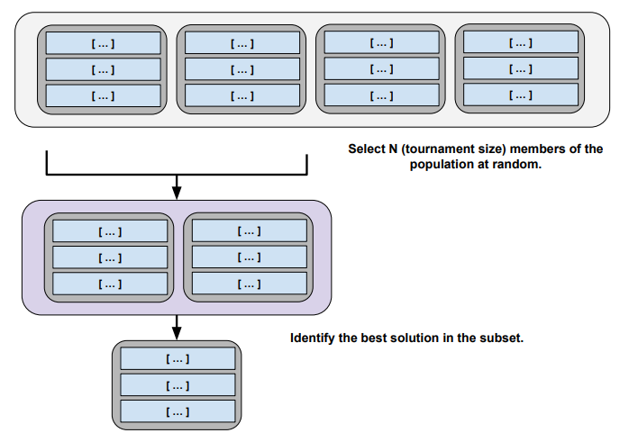
Selection
Rather than searching for best population member:
Select a random subset.
Calculate fitness for each.
Return best.
Notes:
If the population is large, identifying the best members can be an expensive process. To reduce this cost, each time we select two solutions from the current population, we perform a selection procedure on a randomly-chosen subset of the population). The fitness of the members of the chosen subset is compared in a process called “tournament”, and a winner is selected. The winner may not be the best member of the full population, but will be at least somewhat effective, and will be identified at a lower cost than comparing all population members. We also store the score with each population member, so we don’t need to recalculate it if it is selected again.

Slide 41
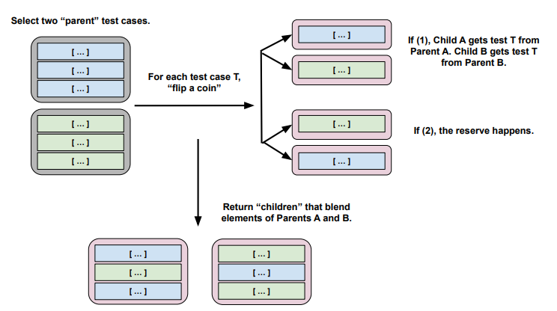
Crossover
Creates two “child” solutions by combining tests from each parent solution.
Notes:
In crossover, we combine individual genes (test cases) of the two selected solutions using the following process: (go over image) If the parents do not contain the same number of test cases, then the remaining cases can be randomly distributed between the children.

Slide 42
Crossover
Single-Point Crossover
Splice at crossover point.
Uniform Crossover
Flip coin at each test, second child gets other option.
Discrete Recombination
Flip coin at each test for both children.
A
B
C
D
A
B
3
4
1
2
3
4
1
2
C
D
A
B
C
D
A
2
3
D
1
2
3
4
1
B
C
4
A
B
C
D
A
2
C
4
1
2
3
4
A
B
3
4
Notes:
What we described is a form of crossover known as “uniform crossover”. There are other means of performing crossover. For example, in “single-point” crossover, a single index is chosen, and one child gets all test cases from Parent A before that index, and all test cases from Parent B from after that index (with the other child getting the reverse). Another form, “discrete recombination”, is similar to uniform crossover, except that we make the coin flip for each child instead of once for both children at each index.

Slide 43
Genetic Algorithm Parameters
All parameters affect solution quality. Usually some experimentation required.
Population Size (default: 20)
Tournament Size (# population members compared during selection, default: 6)
Crossover Probability (default: 0.7)
Mutation Probability (default: 0.7)
Stagnation Threshold (# generations without improvement before ending, default: 30)
Notes:
The following parameters of the genetic algorithm can be adjusted: • Population Size: The size of the population of solutions. By default, we set this to 20. This size must be a even
number in the example implementation. • Tournament Size: The size of the random population subset compared to identify the fittest population members. By default, this is set to 6. • Crossover Probability: The probability that we apply crossover to generate child solutions. By default, 0.7. • Mutation Probability: The probability that we apply mutation to manipulate a solution. By default, 0.7. • Exhaustion Threshold: The number of generations of stagnation allowed before the search is terminated early. By default, we have set this to 30 generations. These parameters can have a noticeable effect on the quality of the solutions located. Getting the best solutions quickly may require some experimentation. However, even at default values, this can be a highly effective method of generating test suites

Slide 44
Examining the Resulting Test Suites
Notes:
disclaimer- this will be a heavily simplified approach - we aren’t handling constraints, this will not be the most efficient, however, I just want to give a good basic example of how you would start to solve this problem. domn’t expect to win speed awards with this or handle complex problems, but this will help illustrate a search-based approach

Slide 45
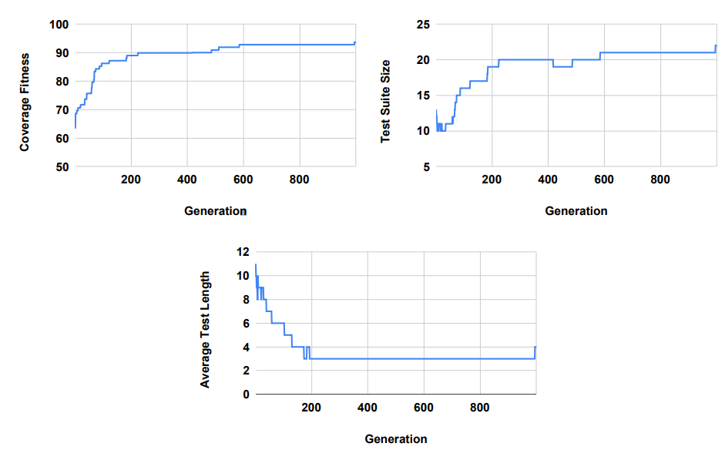
1000 Generations of Evolution
Genetic Algorithm run for 1000 generations for BMICalc.
Stagnation turned off.
Highly variable until ~ 200 generations, then small changes afterwards.
Notes:
Now that we have all of the required components in place, we can generate test suites and examine the results. To illustrate what these results look like, we will generated test suites for the BMI Calc example using the Genetic Algorithm for 1000 generations. During these executions, we disabled the exhaustion threshold to see what would happen if the algorithm was given the full search budget to work. illustrates the results of executing the Genetic Algorithm. We can see the change in fitness over time, as well as the change in the number of test cases in the suite and the average number of actions in test cases. Note that fitness is penalised by the bloat penalty, so the actual statement coverage is higher than the final fitness value. The fitness starts around 63, but quickly climbs until around generation 100, when it hits approximately 86. At generation 717, it hits a fitness value of 92.79, where it remains until near the very end of the execution. At generation 995, a small improvement is found that leads to the coverage of additional code and a fitness increase to 93.67. The test suite size starts at 13 tests, then sheds excess tests for a quick gain in fitness. However, after that, the number of tests rises slowly as coverage increases. For much of the search, the test suite remains around 20 test cases, then 21. At the end, the final suite has 22 test cases. At times, redundant test cases are removed, but instead, we often see redundancy removed through the deletion of actions within individual test cases. The initial test cases are often quite long, with many redundant function calls. Initially, tests have an average of 11 actions. Initially, the number of actions oscillates quite a bit between an average of 8-10 actions. However, over time, the redundant actions are trimmed from test cases. After generation 200, test cases have an average of only three actions until generation 995, when the new test case increases the average length to four actions. We see that the tendency is to produce a large number of very small test cases. This is good, as short test cases are often easier to understand and make it easier to debug the code to find faults.

Slide 46
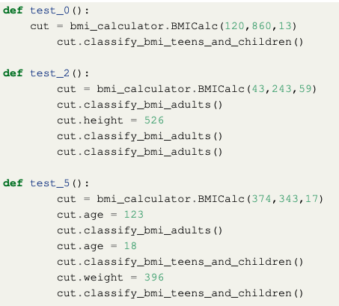
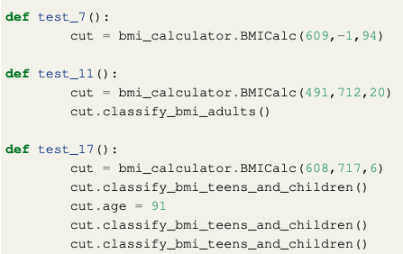
Examples of Generated Test Cases
Notes:
We can look at a few of the tests here. Some test cases look like test_0() and test_11() in the example—a constructor call, followed by a BMI classification. Others will adjust the variable assignments, then make calls. For example, test_5() covers several paths in the code by making assignments, then getting classifications, multiple times. test_7() is an example of one where only a constructor call was needed, as the value supplied—a negative weight, in this case—was sufficient
to trigger an exception. There is still some room for improvement in these test cases. For example, test_2() and test_17() both contain redundant calls to a classification method. It is likely that a longer search budget would remove these calls. It would be simple to simply remove all cases where a method is called twice in a row with the same arguments from the suite. However, in other cases, those calls may have different results (e.g., if class state was modified by the calls), and you would want to leave them in place.

Slide 47

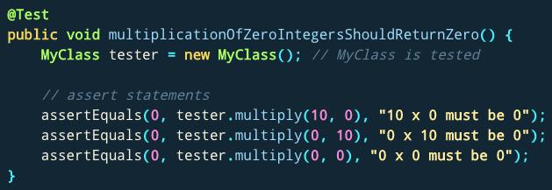
What Do I Do With These Inputs?
If looking for crashes, just run generated input.
If you need to judge correctness, add assertions.
General properties, not specific output.
No: assertEquals(output, 2)
Yes: assertTrue(output % 2 == 0)
Notes:
(title)These test cases lack assertion statements, which are needed to check the correctness of the program behavior. If you’re just looking for crashes or exceptions, you’re done! run them, see if something breaks. You see if something crashes, if there is a memory leak, if there is a buffer overflow, and if any of those happen, there is a problem. Now, sometime you still need something more complicated, something to judge correctness if the test passes. In those cases, you need to add assertions still. Good advice here is not to develop assertions that check for exact values. Instead, if you develop assertions as universal properties (not specific output expected), can apply those to all tests. So, rather than an assertion that says that the outcome if 4 if the input is 2, instead, an assertion that the outcome will be a positive, even number. Something that can be applied either universally or across a wide range of test input.

Slide 48
Additional Concepts
Notes:
disclaimer- this will be a heavily simplified approach - we aren’t handling constraints, this will not be the most efficient, however, I just want to give a good basic example of how you would start to solve this problem. domn’t expect to win speed awards with this or handle complex problems, but this will help illustrate a search-based approach

Slide 49
Not Just Test Generation...
Can be applied to any problem with:
Large search space.
Fitness function and solution generation with low computational complexity.
Approximate continuity in fitness function scoring.
No known optimal solution.
Notes:
Now, it’s not all about just test generation. That’s just one of the things we’re learning how to automate. Metaheuristic search can be applied to any problem where the following four conditions are met:
• A Large Search Space: If there are only a small number of factors to compare, there is no need for a meta-heuristic approach. This is rarely the case, as software engineering typically deals in incredibly large search spaces (i.e. the space of all expressible programs written in the JAVA language).
• Low Computational Complexity: If the first property is met, SBSE algorithms must sample a non-trivial population. A typical run of one of these searches requires thousands of executions of a fitness evaluation. So, the computational complexity of both the fitness function and your solution generator have a major impact on the overall search.
• Approximate Continuity: While it is not necessary for the fitness function to be continuous, too much discontinuity can mislead a search. So, if you take a solution and make a small change to it, the fitness evaluation should be pretty close. Maybe a little better or a little worse, but close. Any search-based optimization must rely on an objective function for guidance, and some level of continuity will ensure that that guidance is accurate.
• No Known Optimal Solutions: If an optimal solution to a problem is already known, then there’s no point in searching for it.
So, there are actually a pretty huge number of SE problems that fit this mold. These techniques are being used to power patch generation, porting of code features to new systems, automated refactoring, and to help solve a number of other problems.

Slide 50
Automated Program Repair
Produce patches for common bug types.
Many bugs can be fixed with just a few changes to the source code - inserting new code, and deleting or moving existing code.
Add null values check.
Change conditional expression.
Move a line within a try-catch block.
Notes:
Unfortunately, the number of reported bugs far outstrips available development resources. It is common for a popular project to have hundreds of new bug reports filed every day. What would you do? How can you keep up? Currently, the answer is “not well”. So, what do we do about that?
automated program Repair techniques, like GenProg, a collaboration between researchers at CMU and UVA in the US, automatically produce patches that can repair common bug types. The idea is that Many bugs can be fixed with just a few changes to a program's source code. Human repairs often involve inserting new code and deleting or moving existing code. GenProg uses those same building blocks to search for repairs automatically. It can make sequences of small edits to the source code, based on common change types. This might include deleting a line of code, adding a check for null values to fix null pointer errors, flipping a < to a >, or other patterns that can avert certain types of bugs. We use these common code edits to try to automatically produce a patch that fixes the code.

Slide 51
Generate and Validate
Genetic programming - solutions represent sequences of edits to the source code.
Generate and validate approach:
Fitness function: how many tests pass?
Patches that pass more tests create new population:
Mutation: Change one edit into another.
Crossover: Merge edits from two parent patches.
Notes:
GenProg usesa process called genetic programming to search for repairs. Our evolutionary computation represents candidate repairs as sequences of edits to software source code. Each candidate in a large population is applied to the original program to produce a new program, which is evaluated using test suites. Those candidates that pass more tests and have a smaller size are said to have a higher fitness and are iteratively subjected to computational analogs of the biological processes of mutation and crossover to produce additional patches where we either mutate an edit into another edit or we combine edits from parent patches. This process terminates when a candidate repair is found that retains all required functionality and fixes the bug.

Slide 52
GenProg Results
Repaired 55/105 bugs at average $8 per bug.
Projects with over 5 million lines of code
Supported by 10000 test cases.
Patch infinite loops, segmentation faults, buffer overflows, denial of service vulnerabilities, “wrong output” faults, and more.
Notes:
In a study of multiple programs, GenProg repaired 55 out of 105 bugs for $8 each - that was the cost of the computation time on Amazon cloud computing servers. The projects studied were pretty large too, totaling over 5 million lines of code, and supported by over 10,000 test cases.
The bugs repaired include many kinds of defects, including infinite loops, segmentation violations, heap buffer overflows, denial-of-service vulnerabilities, stack buffer overflows, string vulnerabilities, integer overflows, and good old fashioned "my program produces the incorrect output" bugs. These techniques are far from fixing all bugs or even most super complicated bugs, but can handle many common, simple bug types without human intervention.

Slide 53
Risks of Automation
Structural coverage is important.
Unless we execute a statement, we’re unlikely to detect a fault in that statement.
More important: how we execute the code.
Humans incorporate context from a project.
“Context” is difficult for automation to derive.
One-size-fits-all approaches.
Notes:
There are some risks in automation in this manner. The first is that these simple metrics that we can calculate with computers, like code coverage, are important. (2) However, more important is how we execute that code, and that involves context and nuance missing in current fitness functions. The current use of things like coverage criteria in automated generation sharply contrasts how those criteria are used by humans. For a human, coverage typically serves an advisory role—as a way to point out gaps in existing efforts. Human testers build suites in which coverage criteria contribute to a toolbox of testing strategies. Humans build and vary their testing strategy based on the needs of their current target. Yet, in automated generation, code coverage might be the only goal, and a single fitness function is often applied at a time. (4-6) where we think all code can be tested in the same way, and that is simple and naive.

Slide 54
Limitations of Automation
Automation produces different tests than humans.
“shortest-path” approach to attaining coverage.
Apply input different from what humans would try.
Execute sequences of calls that a human might not try.
Automation can be very effective, but more work is needed to improve it.
Notes:
As a result, the Tests produced by current automation techniques are very different from human-written tests. they Take a “shortest-path” approach to attaining coverage - small simple tests that cover a lot of code are considered best, when a human doesn’t think that way - they write tests to make the system do interesting things, THEN check coverage to see if they are done. Tests Apply input different from what humans would try. They Execute sequences of method calls that a human might not try. Automation can be very effective, but more work is needed to improve it.

Slide 55
I Want to Try This Out!
Fuzzing often based on metaheuristic search.
AFL (American Fuzzy Lop), Google OSS-Fuzz use genetic algorithms, fitness = code coverage.
http://lcamtuf.coredump.cx/afl/
https://google.github.io/oss-fuz
system-level tests
The Fuzzing Book has tutorials and code for many specialized approaches:
https://www.fuzzingbook.org/

Slide 56
I Want to Try This Out!
Python:
Tutorial for beginners: https://greg4cr.github.io/pdf/21ai4se.pdf
https://github.com/Greg4cr/PythonUnitTestGeneration
EvoSuite for Java: http://www.evosuite.org/
Sapienz (Facebook) tests Android/iOS apps
Will be open-source in end of 2020 2022?.
Older version available
https://github.com/Rhapsod/sapienz/

Slide 57
Summary
+
=
The Metaheuristic
(Algorithm)
Genetic Algorithm
Simulated Annealing
Hill Climber
(...)
The Fitness Functions
(Feedback Strategies)
Distance to Coverage Goals
Count of Executions Thrown
Input or Output Diversity
(...)
(Goals)
Cause Crashes
Cover Code Structure, Maximize Battery Use,
(...)
Notes:
When we create test cases, we are usually searching for tests that fulfill a goal. Such as code coverage. If we have a measurable goal, algorithms can perform a search process, automating the creation of test inputs.
Here is our equation for success algorithm + feedback strategies yields goal-meeting tests. Search-based techniques can be implemented fairly easily - though can also get quite fancy - and are very flexible. Increasingly, they are used to identify program and security flaws.

Slide 58
Next Time
Exercise Session - Mutation Testing
Model-Based Testing and Verification
Reading: Pezze and Young, Ch 5.5, 8, 14
Assignment 2 - Due February 26
Questions?
Assignment 3 - Due March 12
Based on Fault-Based Testing (Lec 11) and Model-Based Testing/Verification (Lectures 13-14)

